Slide 1
instruction for participants via zoom
INAUGURAL ASIA PRO BONO
VIRTUAL CONFERENCE
24-28 SEPTEMBER 2020
www.probonoconference.org

Slide 2
Contents
01
Instruction sheet for Participants Via Zoom
Installing
02
Sharing a reaction
Providing Nonverbal feedback, using annotation tools
03
Listening to language interpretation
Follow the conference in other languages
04
Zoom Best Practice Tips
Audio-visual quality, setting – lighting and space, practice session.

Slide 3
Instruction for Participants Via Zoom
1. Download Zoom App to your desktop, laptop or tablet
Pick a comfortable location to sit at with an uncluttered background. Please do not sit near a fan, an airconditioned room is preferred.
Please use a desktop, laptop or tablet. (Do not use a phone) If using a laptop please plug-in to power as running on battery can adversely affect video quality. If using a tablet, please ensure that the battery is fully charged.
Please find a quiet room (with no echo) and good lighting so that your face does not appear in a shadow.
If possible, have some soft lighting to illuminate your face. Close the window blinds/draw curtains so that you are easy to see on video.
If using a desktop or laptop, connect to the internet via a wired ethernet jack which gives faster and more consistent internet access than Wi-Fi.

Slide 4
Instruction for Participants Via Zoom
2. Your device
On camera suggestions
Wear neutral, solid-colored clothing. Avoid black and white combo, or striped/patterned clothing.
While there is no mandatory dress code, wearing something smart casual. Presenters are also encouraged to wear formal traditional attire.
Keep your head and body relaxed but reasonably still throughout the webinar. Excessive movement (bobbing of head, moving from side to side, front and back) is distracting and may cause video pixilation/ camera focusing issues.
Camera: Position your device so that you are looking into the camera at eye-level rather than looking down (e.g. place your laptop or tablet on a box).
Your camera should be about an arm’s length away from you and adjusted such that your eyes appear around one third from the top of the frame.
Headphones: Or earbuds are highly recommended to avoid audio feedback and echo.
Test your device set up as outlined above at least 1 day before the webinar including your video, audio and internet connection.

Slide 5
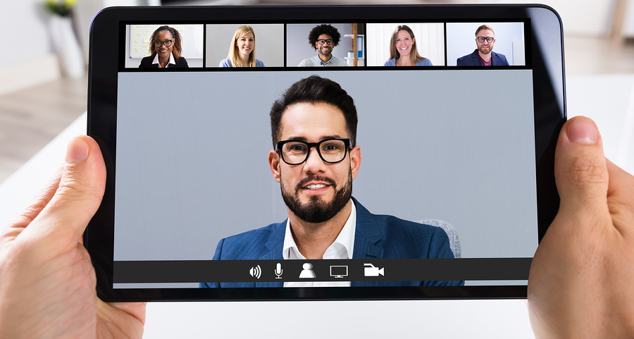
Sharing a reaction
Meeting participants can react during presentation by an emoji to communicate without interrupting the meeting.

Slide 6
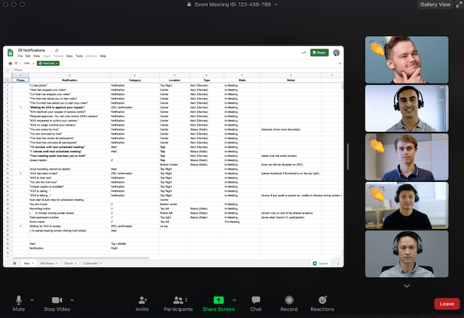
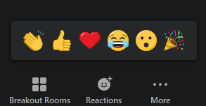
Sharing a reaction
1. In your meeting controls, click Reactions.
3. The reaction will display for 5 seconds.
2. Click the type of reaction you would like to send:
a. Clapping Hands
b. Thumbs up
c. Heart
d. Tears of Joy
e. Open Mouth
f. Party Popper (Tada, Celebration)

Slide 7
Providing Nonverbal feedback
Participants can place an icon beside their name to communicate with the host and other participants without disrupting the flow of the meeting.

Slide 8
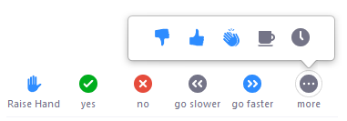
To provide nonverbal feedback to the host of the meeting:
1. Join a Zoom meeting as a participant.
2. Click the Participants button.
3. Click one of the icons to provide feedback to the host.
Click the icon again to remove it.
Note: You can only have one icon active at a time.
For example, by clicking Raise Hand places the raise hand icon beside your name to simulate a hand raise.
All participants can see the icons that everyone else has chosen.
The icon will appear next to your name in the participants list.

Slide 9
To provide nonverbal feedback to the host of the meeting:
• Raise Hand / Lower Hand
• Yes
• No
• Go slower
• Go faster
• Additional icons are available
by clicking the more button:
o Disagree
o Agree
o Clap
o Need a break
o Away

Slide 10
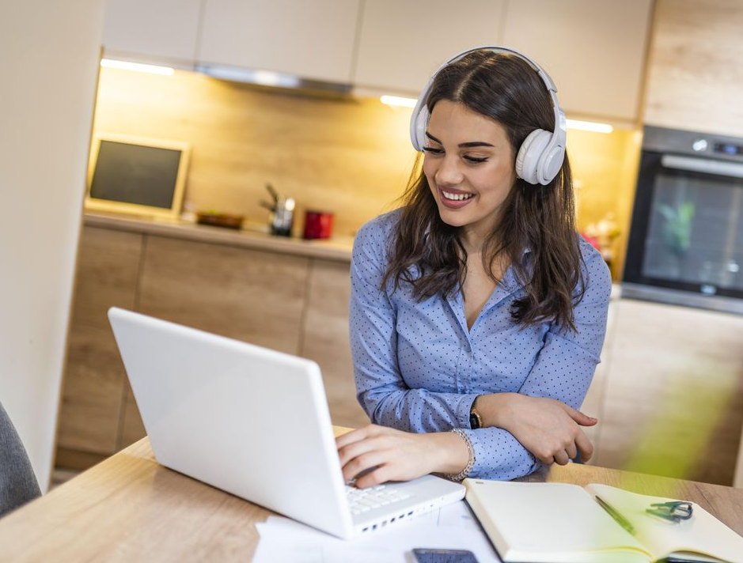
Using annotation tools
Some sessions, presenters might share an online whiteboard and ask participants to participate in the session by using annotation tools.
To use the annotation tools, while viewing a shared screen or shared whiteboard, click View Options then Annotate at the top.
You will see these annotation tools:
.
You will be able to insert text, lines, arrows, shapes, and predefined icons like a check mark or a star.
You will also be able to display spotlights and arrows that display your name.

Slide 11
Listening to language interpretation
While most of the conference sessions will be conducted in English, interpretation for some languages will be available for some of the sessions.

Slide 12
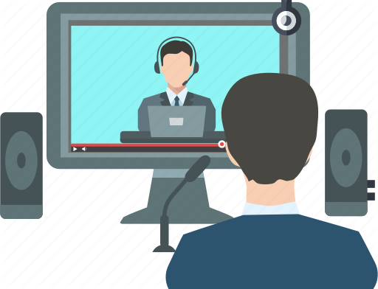
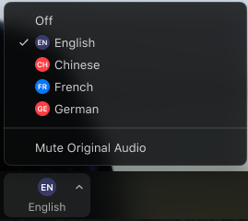
How to conference in other languages ?
2. Select the language that
you would like to hear.
1. Click on the globe icon for interpretation (at the bottom right of your screen).

Slide 13
How to conference in other languages ?
Interpretation for Lao language click Chinese
Interpretation for Urdu language click Urdu
Interpretation for Burmese language click Myanmar
Interpretation for Bangladesh language click Bangladesh
Interpretation for Nepalese language click Nepalese
Interpretation for Hindi language click Hindi

Slide 14
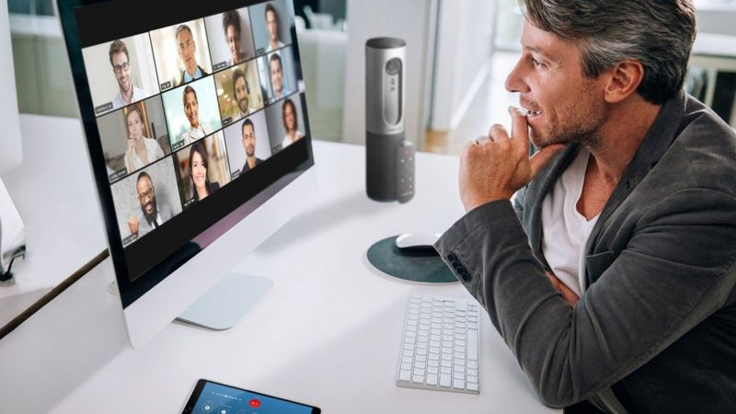
Zoom Best Practice Tips
Audio-visual quality, Setting – lighting and space

Slide 15
Audio-visual quality
Image quality
Use a quality camera with reactive auto-focus and lighting-correction capabilities.
If you do not have a built-in camera, you might opt to use your mobile device, but remember to position it in landscape mode (i.e. horizontally)
Shut down other programs
Restrict other programs that you run, to what you will need, during the Zoom session and keep this to a minimal, shut down all other programs.
This will optimize your audio-visual quality and bandwidth for the session.
Sound quality
If possible, use headphones with a good quality microphone to produce better quality audio.
You may opt to use the earphone with microphone that came with your mobile device but be mindful of the static this may create from movement.

Slide 16
Testing audio quality
Testing your device
-Join a meeting, then click ‘Test speaker and microphone’.
-A pop-up display test your speakers. *If you do not hear the ringtone, click No to switch speakers until you hear it.
-Once you have clicked Yes, another screen will pop-up to test your microphone.
Testing audio quality
You may want to set your audio before/during a meeting by
- Log in to the Zoom client
- Click on your profile picture then click on Settings.
- Click on the Audio tab, access the meeting controls and click on the arrow next to mute/unmute
-Click ‘Audio Options’, which will open your audio settings.
Speaker testing
-To test your speakers, click on Test Speaker to play a test tone.
*If you cannot hear the tone, select a different speaker from the menu or adjust the volume.

Slide 17
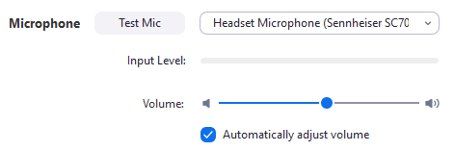
Testing audio quality
Testing Microphone
In the microphone section, you will see the green input bar move when Zoom is picking up audio.
Click test mic to test your microphone. Once you have clicked on it, your audio should start recording. You can also select another microphone from the menu or adjust the input level.
Click on the box next to automatically adjust volume if you want Zoom to adjust the input volume automatically.
For any microphone troubleshooting please look below for help.
** If you are on Mac OS 10.14 Mojave or earlier and cannot access the microphone check your operating system permissions to confirm that Zoom has access to the microphone.
** If you are on Windows 10 and cannot access the microphone, use the Windows search box to navigate to Microphone privacy settings. Switch on the Allow apps to access your microphone toggle and enable access for Zoom.

Slide 18
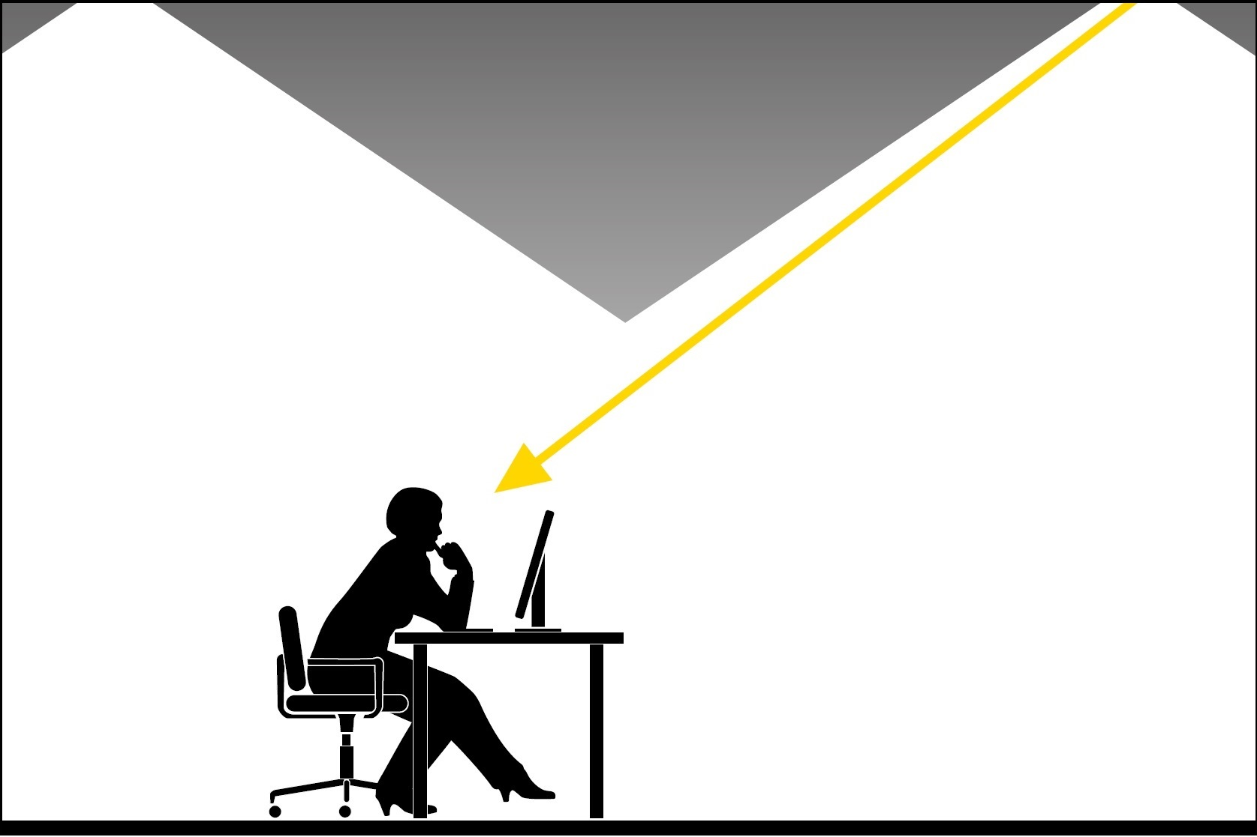
Setting – lighting and space
Direct lighting
Make sure the room you are in has direct lighting hitting your face so everyone can see you clearly.
Avoid sitting under fluorescent lights as they create a flicker or sit in front of a window with natural light coming in if your session is during the day.
Bright walls
If possible, sit in front of a bright wall or bookcase

Slide 19
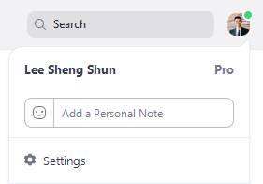
Using Virtual Background
1. Download Justice Hero background to your desktop, laptop or tablet
3. Select Virtual Background.
*Note: If you do not have the Virtual Background tab and you have enabled it on the web portal, sign out of the Zoom Desktop Client and sign in again.
2. Sign in to the Zoom desktop client. Click your profile picture, then click Settings.

Slide 20
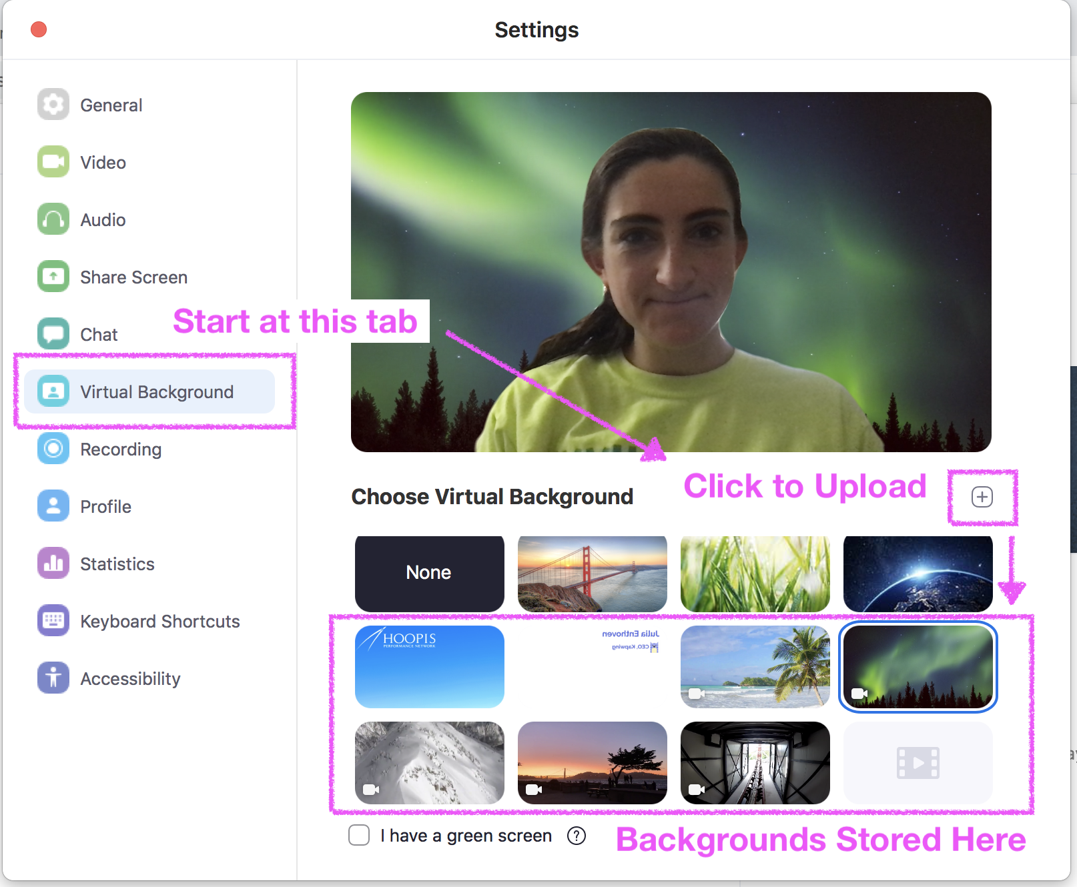
Using Virtual Background
4. Check I have a green screen if you have a physical green screen set up.
You can then click on your video to select the correct color for the green screen.
5. Click on an image to add your own Justice Hero image by clicking + and choosing your downloaded image location in your device.

Slide 21
Using Virtual Background
5. If prompted, click Download to download the package for virtual background without a green screen.
Notes:
Ensure that you are using a solid background color.
After you select an option, that virtual background will display during your meetings.
To disable Virtual Background, choose the option None..

Slide 22
Practice session
How to join training session

Slide 23
How to join training session
If the main host sends an email invitation you can see the details via the information on the email. In the email there should be a link to the session as well as the provided password if necessary.
To access the session, click on the link which will take you to another page in which it will give you either the option to launch or download Zoom if you haven’t downloaded Zoom yet. Once you have launched Zoom, there will either be a pop-up that says Waiting for the host to start this meeting meaning that the session hasn’t started yet, which is a good time to check that your audio quality is working and explore the settings.
You can also opt to directly join the session from the Zoom app where you can also view all your upcoming Zoom meetings in the meetings tab and select the meeting that you want to go to and click join.

Slide 24
More infomation
If you would like to read more,…
The following links are useful resources:
4 Tips for Getting the Most Out of Zoom Video Conferencing
https://blog.zoom.us/wordpress/2013/08/29/how-to-get-the-most-out-of-your-zoom-experience/
7 Video Conference Lighting Tips for the Perfect Video Call
https://www.lifesize.com/en/video-conferencing-blog/video-conference-lighting

Slide 25
Useful Links:
Video conferencing
set-up tips
Zoom user information
How to join training session
Testing computer & device audio:
https://www.youtube.com/watch?v=rQwanxQmFnc
(4 minutes)
https://youtu.be/FAhb8POx7_0
(1 minute 30 seconds)
https://support.zoom.us/hc/en-us/articles/201362193-Joining-a-Meeting
https://www.youtube.com/embed/hIkCmbvAHQQ?rel=0&autoplay=1&cc_load_policy=1 (1 minutes 9 seconds)
https://support.zoom.us/hc/en-us/articles/201362283-Testing-computer-or-device-audio

Slide 26
Supporters

Slide 27
Thanks!
Any questions?
Contact BABSEACLE :
apbc-secretariat@asiapbc.org

Slide 28
BABSEACLE
INAUGURAL ASIA PRO BONO VIRTUAL CONFERENCE
Asia Pro Bono Virtual Conference & A2J Exchange
National CLE Mock Pre-Trial Hearing Workshop
2020 Asia Regional CLE Mock Trial Event
The Global Pro Bono Move

